Slide 1
POCO C++ Library Log
조욱래
2012-12-21

Slide 2
Logging
POCO logging framework.

Slide 3
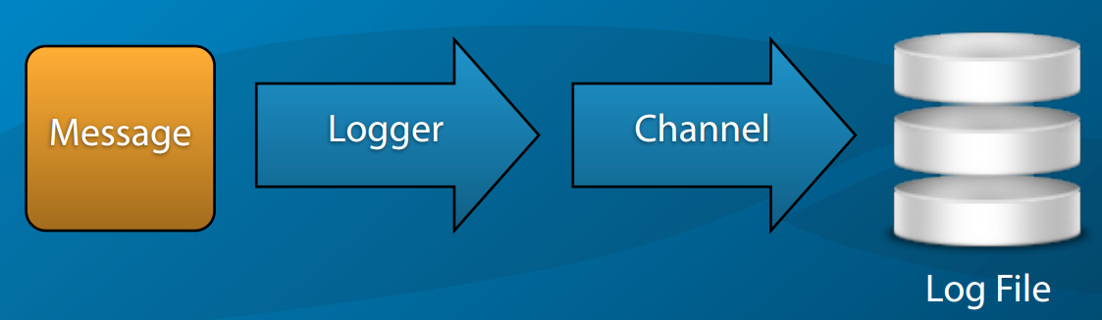
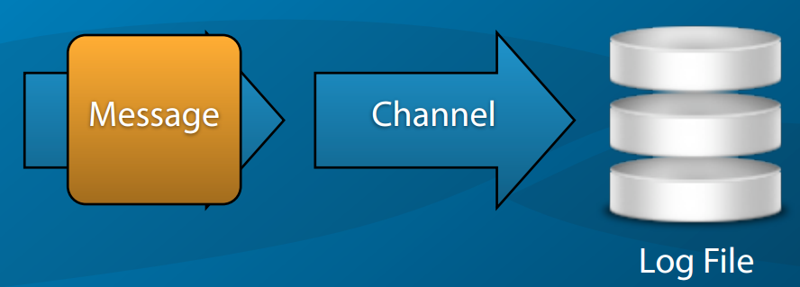
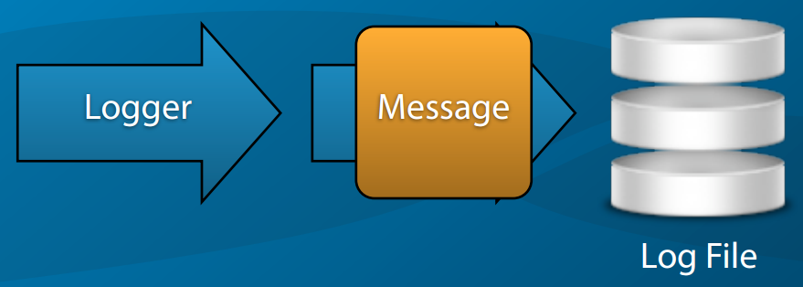
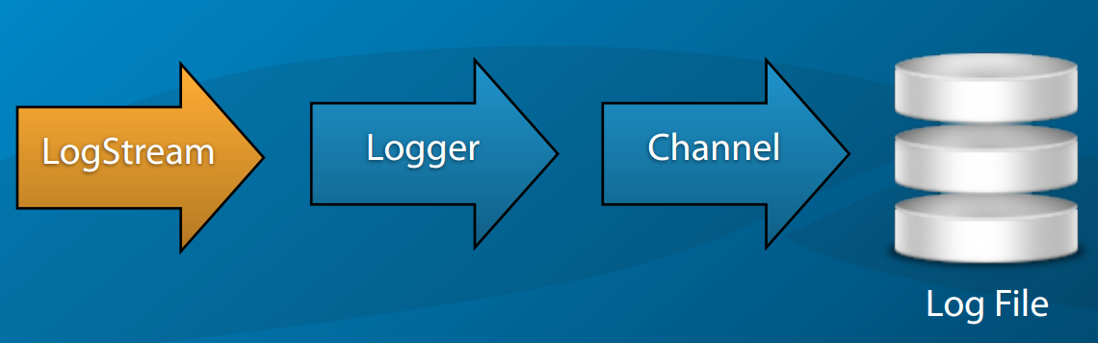
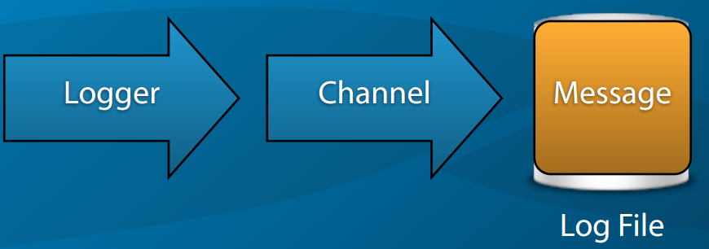
Logging Architecture

Slide 4
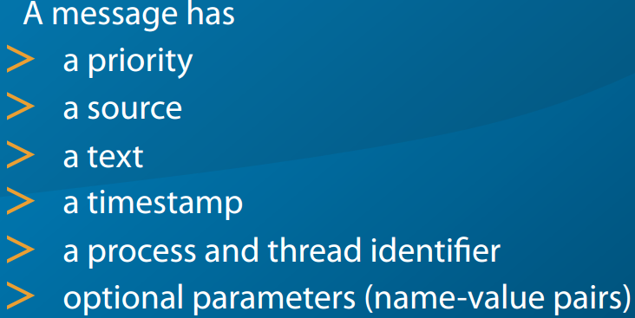
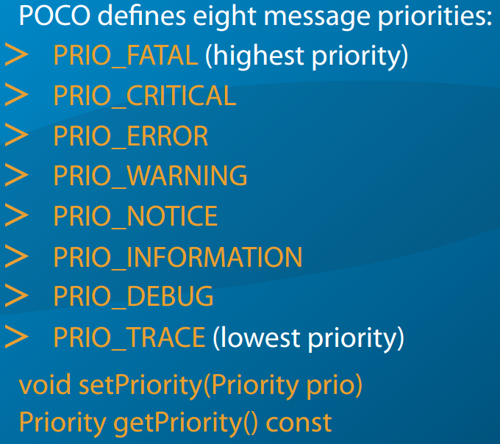
Log Messages

Slide 5
Logger
Entry point into the logging framework.
Class to generate log messages.
has an attached Channel
, which delivers the messages to their destination (possibly, via other channels).
has a name
The name is set upon creation and cannot be changed later
Filters messages based on their priority.

Slide 6
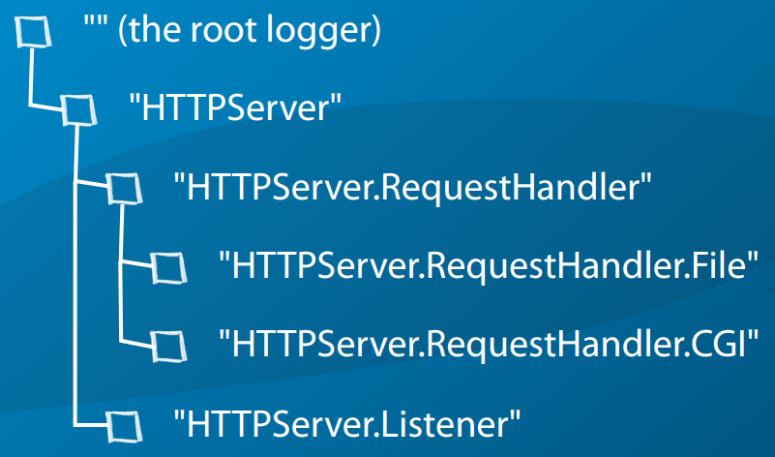
Logger Hierarchy Example

Slide 7

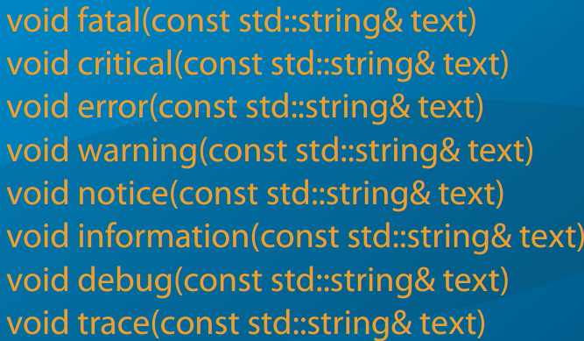
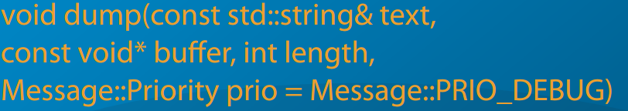
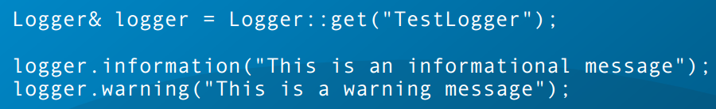

Slide 8
Channels
for delivering messages (Poco::Message) to their destination
(e.g., the console or a log file).
Channel Properties
void setProperty(const std::string& name, const std::string& value)
std::string getProperty(const sdt::string& name)

Slide 9
Channels Type
ConsoleChannel
std::clog
WindowsConsoleChannel
NullChannel
SimpleFileChannel
File size limit & rotation
FileChannel (+ gzip , purge)
EventLogChannel
SyslogChannel
AsyncChannel

Slide 10
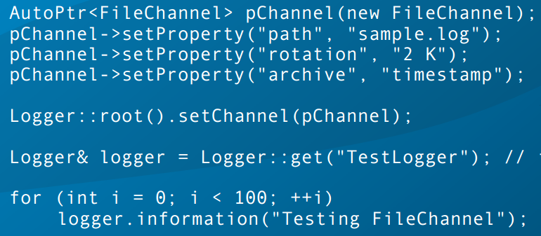
FileChannel
full-blown log file support.
Supports automatic archiving. (gzip)
rotation based on ﬁle sizes or time intervals
.

Slide 11
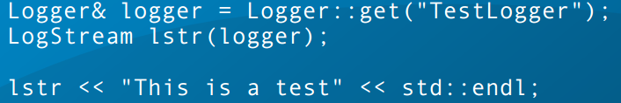
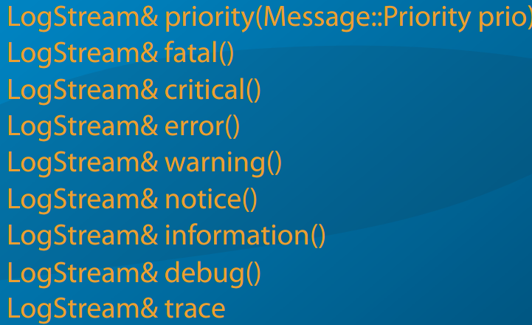
LogStream
ostream interface to a Logger
terminated with std::endl

Slide 12
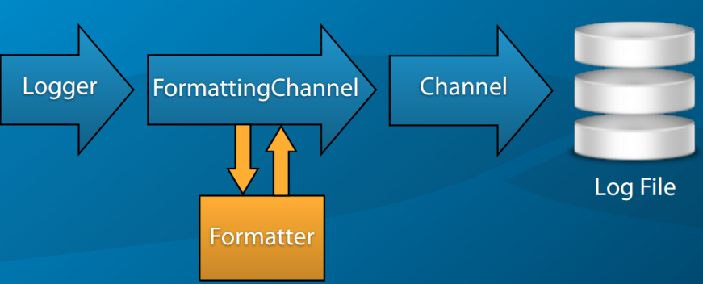
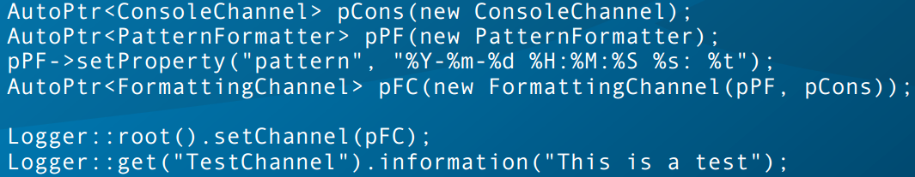
Message Formatting

Slide 13
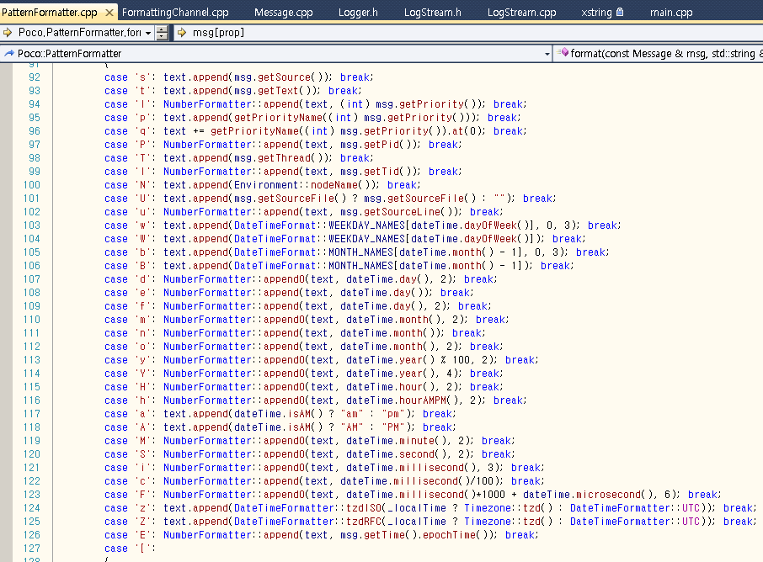
%로시작하는 Log 포맷 약어.

Slide 14
KLP log 설정
# logger 설정
logging.loggers.root.channel = root_channel
logging.loggers.root.level = trace
# user gateway log
logging.loggers.user_gateway.name = klp.user_gateway
logging.loggers.user_gateway.channel = user_gateway_file_channel
logging.loggers.user_gateway.level = trace
logging.channels.root_channel.class = FileChannel
logging.channels.root_channel.formatter = user_gateway_file_format
logging.channels.root_channel.path = root.log
logging.channels.user_gateway_file_channel.class = FileChannel
logging.channels.user_gateway_file_channel.formatter = user_gateway_file_format
logging.channels.user_gateway_file_channel.path = user_gateway.log
logging.formatters.user_gateway_file_format.class = PatternFormatter
logging.formatters.user_gateway_file_format.pattern = %N,%Y.%n.%e %H:%M:%S,%t
logging.formatters.user_gateway_file_format.times = local
# room server log
logging.loggers.App.name = klp.room_server
logging.loggers.App.channel = room_server_file_channel
logging.loggers.App.level = trace
logging.channels.room_server_file_channel.class = FileChannel
logging.channels.room_server_file_channel.formatter = room_server_file_format
logging.channels.room_server_file_channel.path = room_server.log
logging.formatters.room_server_file_format.class = PatternFormatter
logging.formatters.room_server_file_format.pattern = %N,%Y.%n.%e %H:%M:%S,%t
logging.formatters.room_server_file_format.times = local
# user gateway server 설정
klp.user_gateway.client.listen.ip = 0.0.0.0
klp.user_gateway.client.listen.port = 10001
# lobby server log
logging.loggers.lobby.name = klp.lobby
logging.loggers.lobby.channel = lobby_file_channel
logging.loggers.lobby.level = trace
logging.channels.lobby_file_channel.class = FileChannel
logging.channels.lobby_file_channel.formatter = lobby_file_format
logging.channels.lobby_file_channel.path = lobby.log
logging.formatters.lobby_file_format.class = PatternFormatter
logging.formatters.lobby_file_format.pattern = %N,%Y.%n.%e %H:%M:%S,%t
logging.formatters.lobby_file_format.times = local
# lobby server 설정
lobby.pmb.ip = 127.0.0.1
lobby.pmb.port = 5672
klp.common.pmb.ip = 127.0.0.1
klp.common.pmb.port = 5672

